Slide 1
Number Theory
Pelatnas 1 – 2018
Vincent Alfred
Universitas Bina Nusantara

Slide 2

Prime Numbers
$$2, 3, 5, 7, …$$

Slide 3

Primality Test
$$O\left(\sqrt{n} \right)$$

Slide 4
Generating Prime
Sieve of Eratosthenes

Slide 5
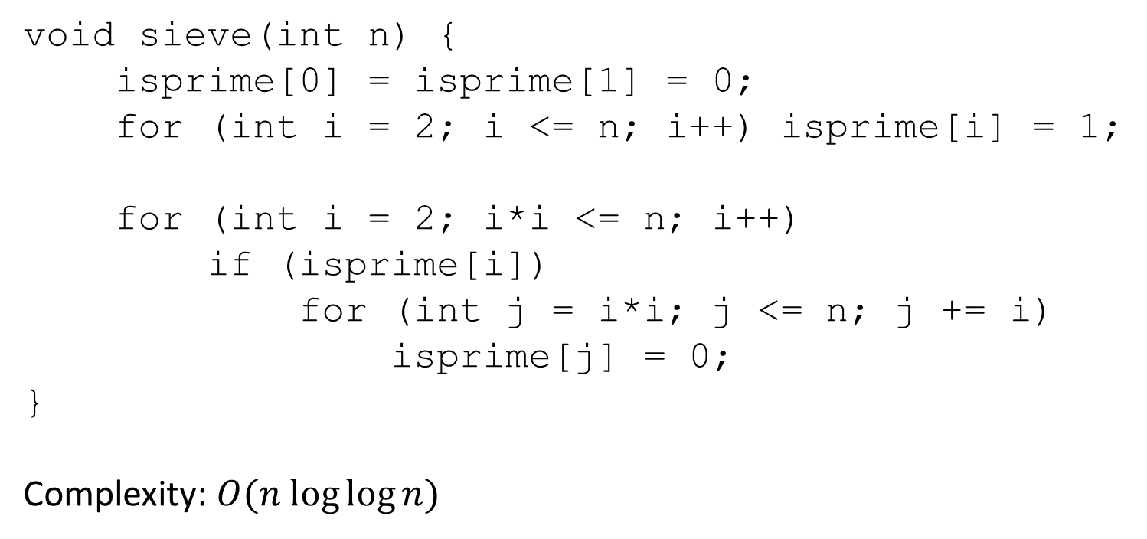
void sieve(int n) {
isprime[0] = isprime[1] = 0;
for (int i = 2; i <= n; i++) isprime[i] = 1;
for (int i = 2; i*i <= n; i++)
if (isprime[i])
for (int j = i*i; j <= n; j += i)
isprime[j] = 0;
}
Complexity: $O(n log⁡log⁡n)$

Slide 6
Multiplicative Function

Slide 7

Multiplicative function is …
Arithmetic function $f(n)$ where
$f\left(1\right)=1$
and
$f\left(ab\right)=f\left(a\right)⋅f(b)$ if $a$ and $b$ are coprime.

Slide 8
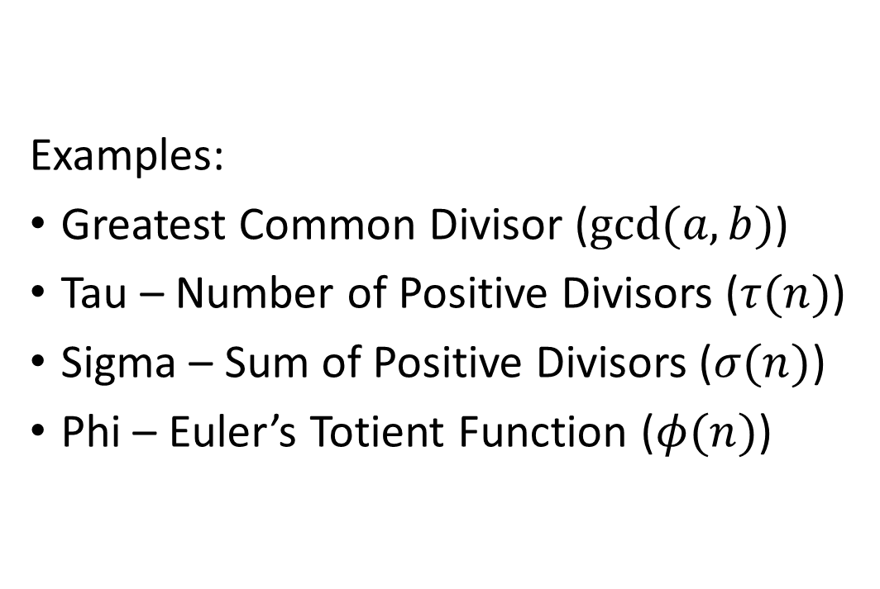
Examples:
Greatest Common Divisor ($gcd⁡(a, b)$)
Tau – Number of Positive Divisors ($τ(n)$)
Sigma – Sum of Positive Divisors ($σ(n)$)
Phi – Euler’s Totient Function ($φ(n)$)

Slide 9
Euclidean Algorithm
Greatest Common Divider

Slide 10
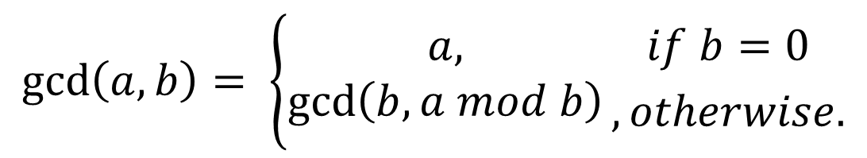
$$\gcd\left(a, b\right)= \left\{\begin{aligned}a, \\ \gcd\left(b, a mod b\right)\end{aligned}{if b=0 \atop , otherwise.}\right.$$

Slide 11
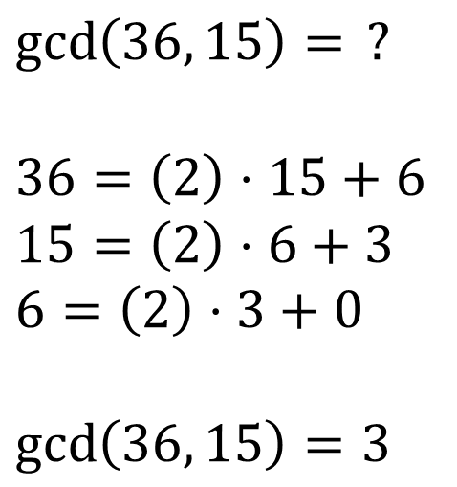
$$\gcd\left(36, 15\right)= ?$$
$$36=\left(2\right)⋅15+6$$
$$15=\left(2\right)⋅6+3$$
$$6=\left(2\right)⋅3+0$$
$$\gcd\left(36, 15\right)=3$$

Slide 12

int gcd (int a, int b) {
if (b == 0)
return a;
else
return gcd (b, a % b);
}
or
__gcd(a, b);
Complexity: $O(\log{\min{(a, b))}}$

Slide 13
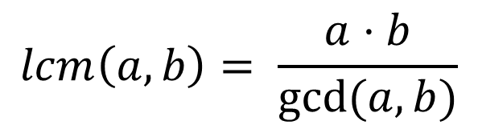
$$lcm\left(a, b\right)= \frac{a⋅b}{gcd⁡(a, b)}$$

Slide 14


Tau – $τ\left(n\right)$
Number of positive divisors of a given number $n$

Slide 15
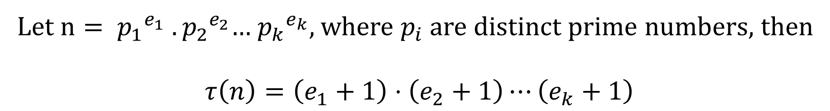
Let $n= {p_{1}}^{e_{1}} .{p_{2}}^{e_{2}}$… ${p_{k}}^{e_{k}}$, where $p_{i}$ are distinct prime numbers, then
$$τ\left(n\right)=\left(e_{1}+1\right)⋅\left(e_{2}+1\right)⋯\left(e_{k}+1\right)$$

Slide 16


Sigma – $σ\left(n\right)$
Sum of positive divisors of a given number $n$

Slide 17
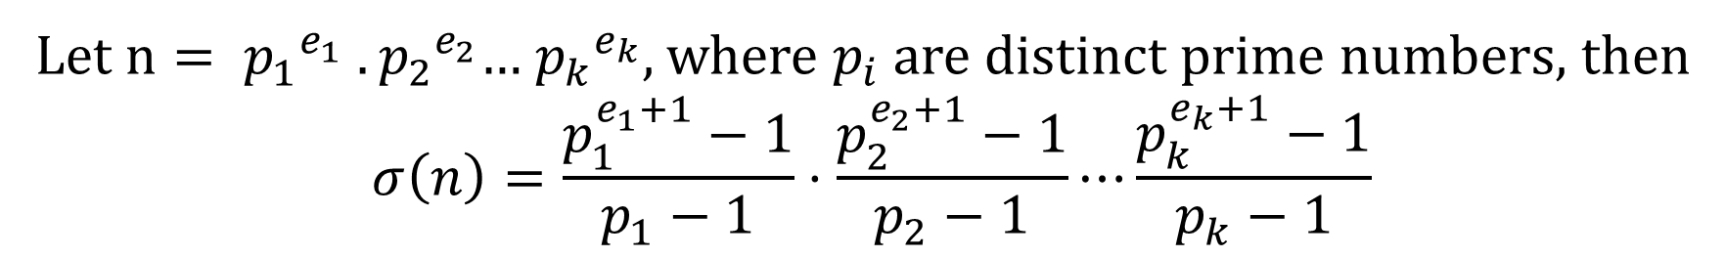
Let $n= {p_{1}}^{e_{1}} .{p_{2}}^{e_{2}}$… ${p_{k}}^{e_{k}}$, where $p_{i}$ are distinct prime numbers, then
$$σ\left(n\right)=\frac{p_{1}^{e_{1}+1}−1}{p_{1}−1}⋅\frac{p_{2}^{e_{2}+1}−1}{p_{2}−1}⋯\frac{p_{k}^{e_{k}+1}−1}{p_{k}−1}$$

Slide 18
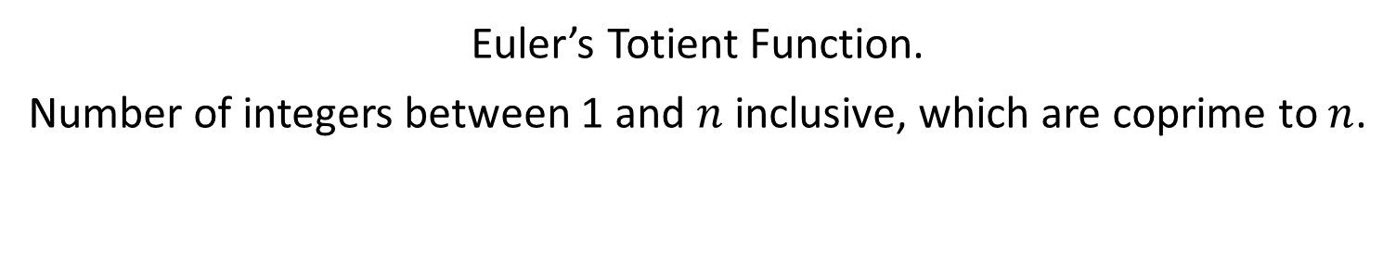

Phi – $φ\left(n\right)$
Euler’s Totient Function.
Number of integers between 1 and $n$ inclusive, which are coprime to $n$.

Slide 19
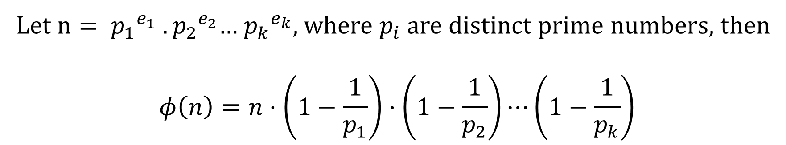
Let $n= {p_{1}}^{e_{1}} .{p_{2}}^{e_{2}}$… ${p_{k}}^{e_{k}}$, where $p_{i}$ are distinct prime numbers, then
$$φ\left(n\right)=n⋅\left(1−\frac{1}{p_{1}}\right)⋅\left(1−\frac{1}{p_{2}}\right)⋯\left(1−\frac{1}{p_{k}}\right)$$

Slide 20

Extended Euclidean
$$ax+ by=\gcd\left(a, b\right)$$
Given $a$ and $b$, find $x$ and $y$.

Slide 21
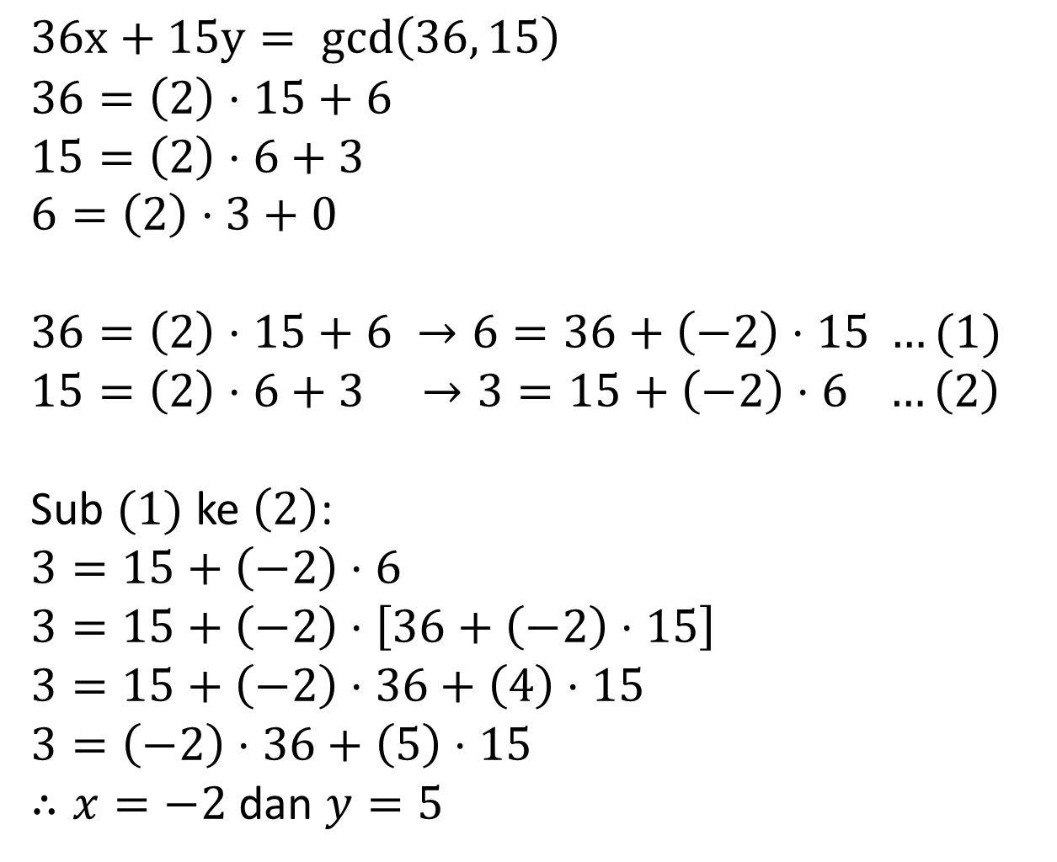
$$36x+15y= gcd\left(36, 15\right)$$
$$36=\left(2\right)⋅15+6$$
$$15=\left(2\right)⋅6+3$$
$$6=\left(2\right)⋅3+0$$
$$36=\left(2\right)⋅15+6 →6=36+\left(−2\right)⋅15 …(1)$$
$$15=\left(2\right)⋅6+3 →3=15+\left(−2\right)⋅6 …\left(2\right)$$
Sub $(1)$ ke $\left(2\right)$:
$$3=15+\left(−2\right)⋅6$$
$$3=15+\left(−2\right)⋅\left[36+\left(−2\right)⋅15\right]$$
$$3=15+\left(−2\right)⋅36+\left(4\right)⋅15$$
$$3=\left(−2\right)⋅36+\left(5\right)⋅15$$
$∴x=−2$ dan $y=5$

Slide 22
void extendedEuclid(int a, int b) {
if (b == 0) { x = 1; y = 0; d = a; return; }
extendedEuclid(b, a%b);
int x1 = y;
int y1 = x - (a/b) * y;
x = x1;
y = y1;
}

Slide 23

Linear Diophantine
$$ax+by=c$$
Given $a, b$ and $c$, find $x$ and $y$.

Slide 24
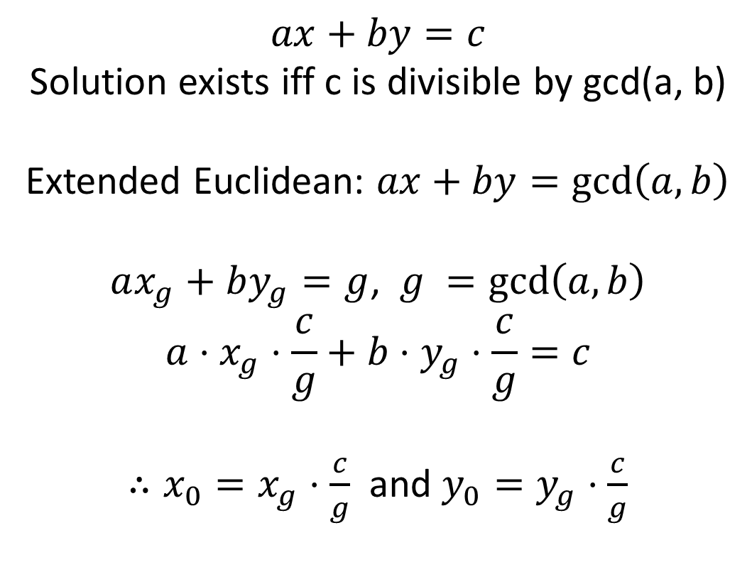
$$ax+by=c$$
Solution exists iff c is divisible by gcd(a, b)
Extended Euclidean: $ax+by=\gcd\left(a, b\right)$
$ax_{g}+by_{g}=g$, $g =\gcd\left(a, b\right)$
$$a⋅x_{g}⋅\frac{c}{g}+b⋅y_{g}⋅\frac{c}{g}=c$$
$∴x_{0}=x_{g}⋅\frac{c}{g}$ and $y_{0}=y_{g}⋅\frac{c}{g}$

Slide 25
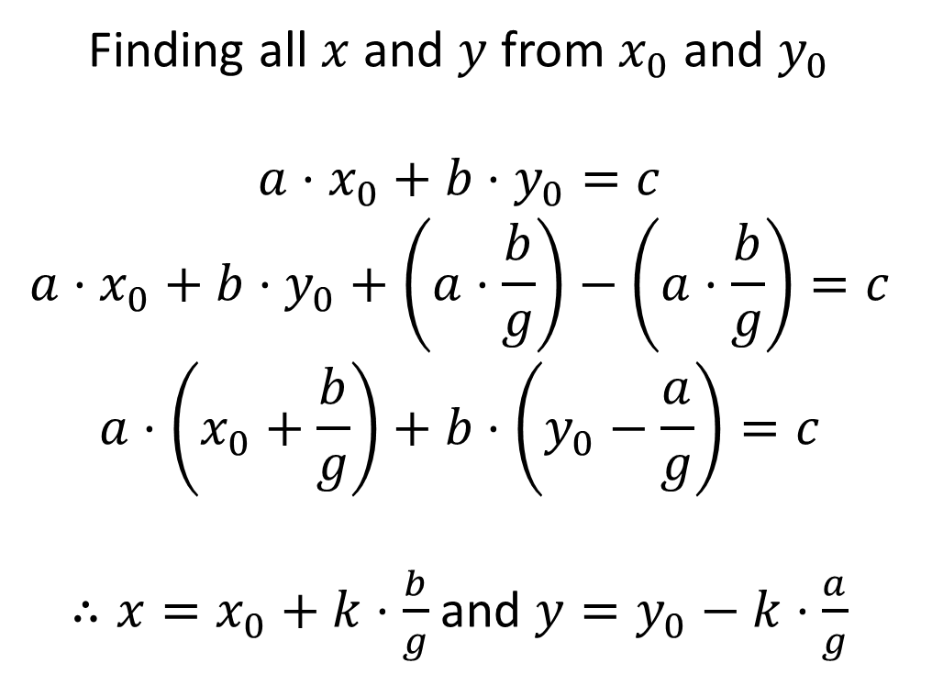
Finding all $x$ and $y$ from $x_{0}$ and $y_{0}$
$$a⋅x_{0}+b⋅y_{0}=c$$
$$a⋅x_{0}+b⋅y_{0}+\left(a⋅\frac{b}{g}\right)−\left(a⋅\frac{b}{g}\right)=c$$
$$a⋅\left(x_{0}+\frac{b}{g}\right)+b⋅\left(y_{0}−\frac{a}{g}\right)=c$$
$∴x=x_{0}+k⋅\frac{b}{g}$ and $y=y_{0}−k⋅\frac{a}{g}$

Slide 26
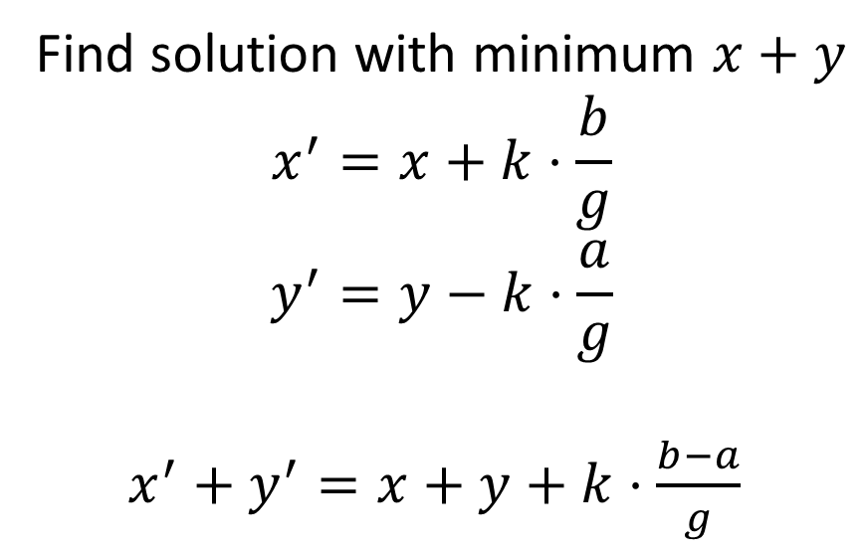
Find solution with minimum $x+y$
$$x^{′}=x+k⋅\frac{b}{g}$$
$$y^{′}=y−k⋅\frac{a}{g}$$
$x^{′}+y^{′}=x+y+k⋅\frac{b−a}{g}$

Slide 27

Problem: CF 633A – Ebony and Ivory
Given $A, B$ and $C,$check if there exist $x$ and $y$ which satisfy $Ax + By = C$
Constraint:
$1≤a, b≤100$
$1≤c≤10000$

Slide 28

Problem: UVA 12775 – Gift Dilemma
Given $A, B, C$ and $P,$find numbers of ways where $Ax + By + Cz = P$
Constraint:
$TC≤100$
$0<A, B, C, P≤{10}^{8}$
$\frac{C}{\gcd\left(A, B, C\right)}≥200$

Slide 29
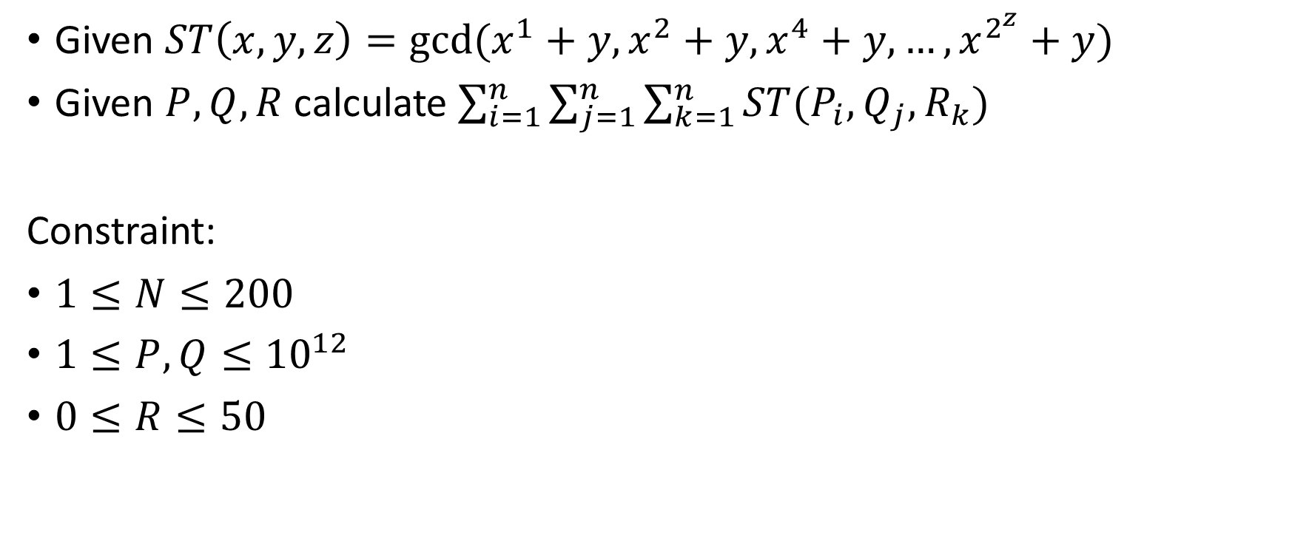
Problem: Final BNPCHS 2018 – Super Trombosit
Given $ST\left(x, y, z\right)=gcd⁡(x^{1}+y,x^{2}+y, x^{4}+y, …,x^{2^{z}}+y)$
Given $P, Q, R$ calculate $\sum_{i=1}^{n}{\sum_{j=1}^{n}{\sum_{k=1}^{n}{ST(P_{i}, Q_{j}, R_{k})}}}$
Constraint:
$1≤N≤200$
$1≤P, Q≤{10}^{12}$
$0≤R≤50$

Slide 30
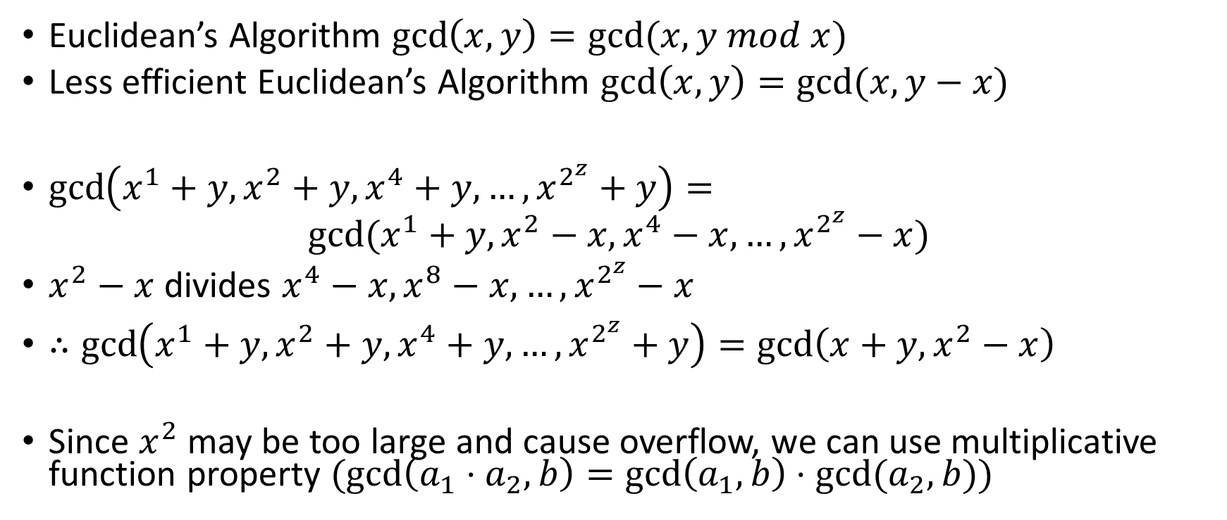
Problem: Final BNPCHS 2018 – Super Trombosit
Euclidean’s Algorithm $\gcd\left(x, y\right)=gcd⁡(x, y mod x)$
Less efficient Euclidean’s Algorithm $\gcd\left(x, y\right)=gcd⁡(x, y−x)$
$\gcd\left(x^{1}+y,x^{2}+y, x^{4}+y, …,x^{2^{z}}+y\right)=$ $gcd⁡(x^{1}+y,x^{2}−x, x^{4}−x, …,x^{2^{z}}−x)$
$x^{2}−x$ divides $x^{4}−x, x^{8}−x, …, x^{2^{z}}−x$
$∴\gcd\left(x^{1}+y,x^{2}+y, x^{4}+y, …,x^{2^{z}}+y\right)=\gcd\left(x+y, x^{2}−x\right)$
Since $x^{2}$ may be too large and cause overflow, we can use multiplicative function property $(gcd\left(a_{1}⋅a_{2},b\right)=\gcd\left(a_{1},b\right)⋅gcd⁡(a_{2},b))$

Slide 31
Matrix Power

Slide 32
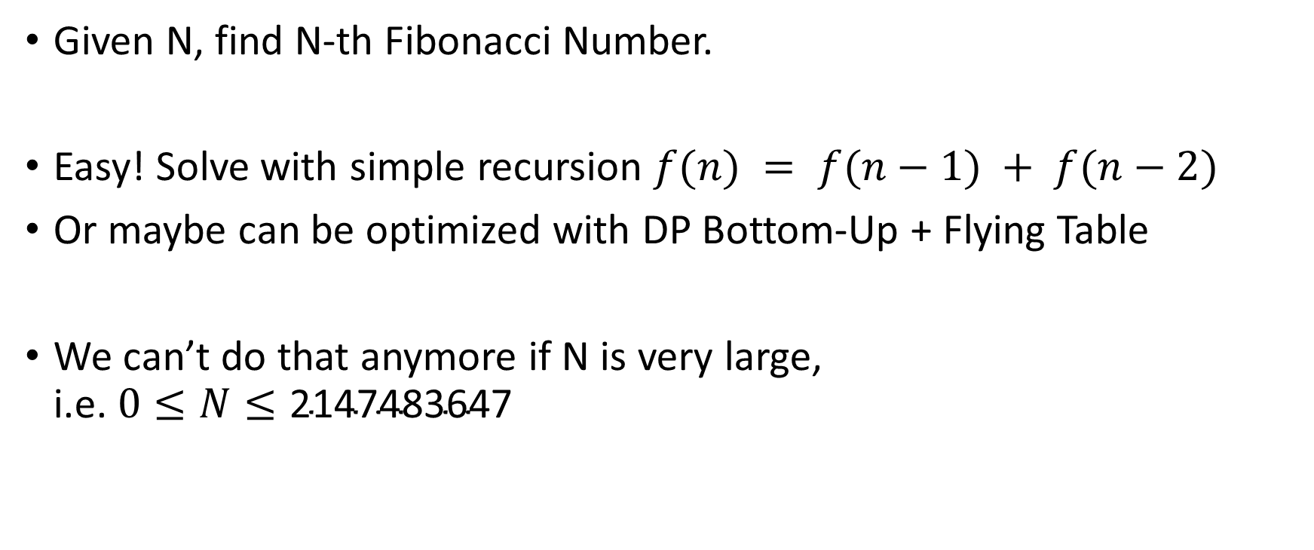
Motivational Problem
Given N, find N-th Fibonacci Number.
Easy! Solve with simple recursion $f(n) = f(n−1) + f(n−2)$
Or maybe can be optimized with DP Bottom-Up + Flying Table
We can’t do that anymore if N is very large, i.e. $0≤N≤\text{2147483647}$

Slide 33
Linear recurrence relation
Each term is a linear combination of previous terms.

Slide 34

Find number of terms effecting the sequence (k).
For Fibo sequence it is 2.
Set the initial matrix with size $k×1$, $F_{1}$
$$F_{1}=\left[\begin{matrix}f(1) \\ f(2)\end{matrix}\right]$$

Slide 35

Construct a matrix size $k×k$ (transformation matrix) which satisfy $TF_{i}=F_{i+1}$
$$T= \left[\begin{matrix}0 & 1 \\ 1 & 1\end{matrix}\right]$$
$$F_{N}= T^{N−1}F_{1}$$

Slide 36
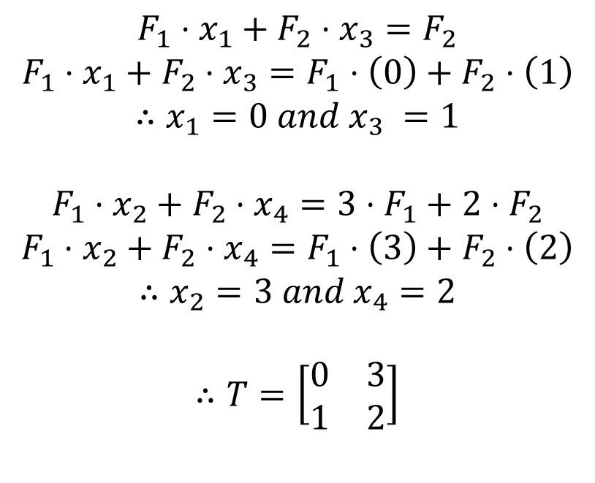
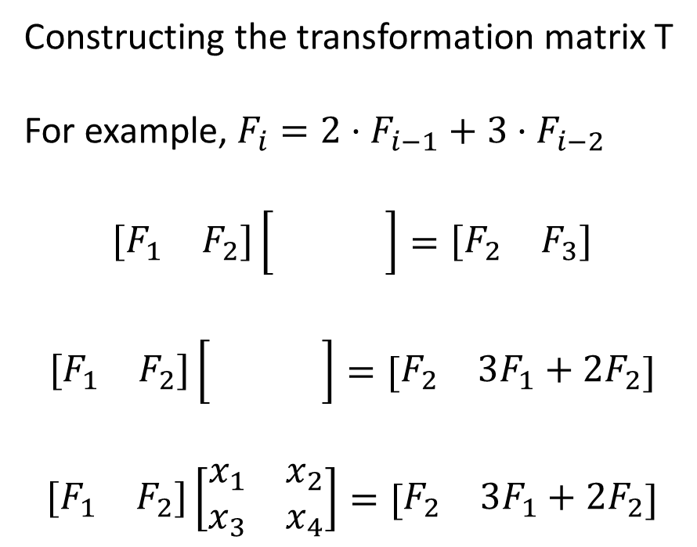
Constructing the transformation matrix T
For example, $F_{i}={2⋅F}_{i−1}+{3⋅F}_{i−2}$
$$\left[\begin{matrix}F_{1} & F_{2}\end{matrix}\right]\left[\begin{matrix} & \\ & \end{matrix}\right]=\left[\begin{matrix}F_{2} & F_{3}\end{matrix}\right]$$
$$\left[\begin{matrix}F_{1} & F_{2}\end{matrix}\right]\left[\begin{matrix} & \\ & \end{matrix}\right]=[\begin{matrix}F_{2} & 3F_{1}+2F_{2}\end{matrix}]$$
$$\left[\begin{matrix}F_{1} & F_{2}\end{matrix}\right]\left[\begin{matrix}x_{1} & x_{2} \\ x_{3} & x_{4}\end{matrix}\right]=[\begin{matrix}F_{2} & 3F_{1}+2F_{2}\end{matrix}]$$
$$F_{1}⋅x_{1}+F_{2}⋅x_{3}=F_{2}$$
$$F_{1}⋅x_{1}+F_{2}⋅x_{3}={F_{1}⋅\left(0\right)+F}_{2}⋅\left(1\right)$$
$$∴x_{1}=0 and x_{3} =1$$
$$F_{1}⋅x_{2}+F_{2}⋅x_{4}=3⋅F_{1}+2⋅F_{2}$$
$$F_{1}⋅x_{2}+F_{2}⋅x_{4}=F_{1}⋅\left(3\right)+F_{2}⋅\left(2\right)$$
$$∴x_{2}=3 and x_{4}=2$$
$$∴T=\left[\begin{matrix}0 & 3 \\ 1 & 2\end{matrix}\right]$$

Slide 37
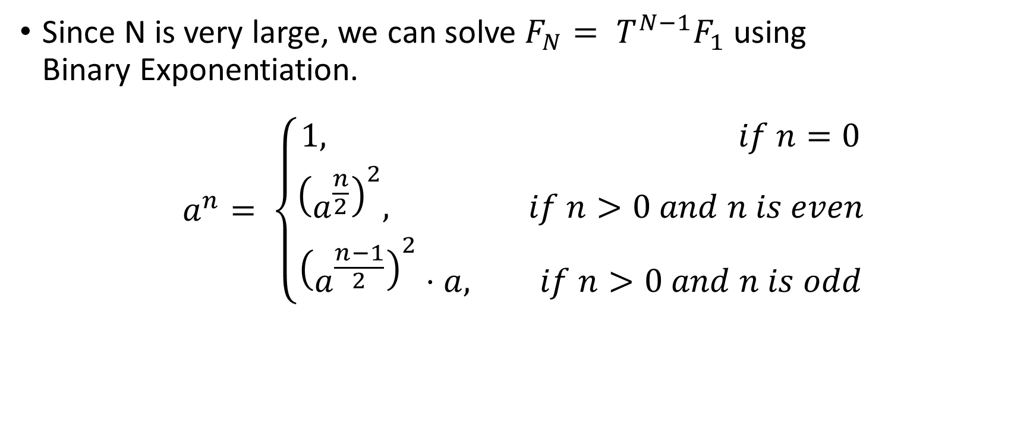
Since N is very large, we can solve $F_{N}= T^{N−1}F_{1}$ using Binary Exponentiation.
$$a^{n}= \left\{\begin{aligned}1, if n=0 \\ {\left(a^{\frac{n}{2}}\right)}^{2}, if n>0 and n is even \\ {\left(a^{\frac{n−1}{2}}\right)}^{2}⋅a, if n>0 and n is odd\end{aligned}\right.$$

Slide 38

Problem: UVA 10229 – Modular Fibonacci
Given $F_{0}=0, F_{1}=1, and F_{i}=F_{i−1}+F_{i−2} for i>1$
Given $n (0≤n≤\text{2147483647}$) and $m (0≤m≤20)$
Find $Fn mod 2^{m}$

Slide 39
Thank You

